Slide 1



CARBON FOOTPRINT CALCULATOR
Submitted by :
Noel Joseph Kurian
Nora Sierra Nebu
Parvana Mohan
Pooja Reji
Poorna Sidharth
Poornasreee K J

Slide 2
TABLE OF CONTENTS
1. WHAT IS CARBON FOOTPRINT?
2. WHAT IS THE PROBLEM? WHY DO WE NEED A CALCULATOR?
3.OUR WEBSITE
4.SUSTAINABILITY ANALYSIS
5.HOW CAN WE REDUCE EMISSIONS?
6.CONCLUSION & FUTURE IMPROVEMENTS

Slide 3



ENVIRONMENTAL PROBLEM: HIGH CARBON EMISSIONS
  Increasing greenhouse gas emissions
  Major contributors: transportation, electricity, industries, food, and waste
  Leads to global warming and climate change
  Need for awareness and reduction of individual emissions

Slide 4
WHAT IS CARBON FOOTPRINT ?
The total amount of greenhouse gases released into the atmosphere as a result of our activities, usually expressed as carbon dioxide equivalent (CO₂e).
  Mainly associated with carbon dioxide (CO₂) and other greenhouse gases
  Measured in CO₂ equivalent (CO₂e)
  Generated directly or indirectly by our daily activities
Examples:
  Transportation
  Electricity usage
  Food consumption
  Production and purchase of goods
  Waste generation

Slide 5

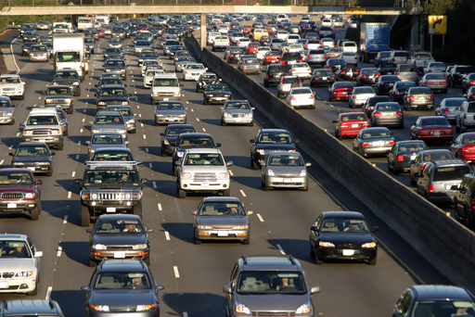
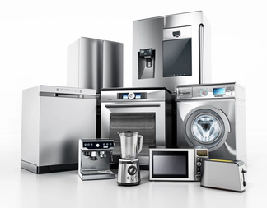
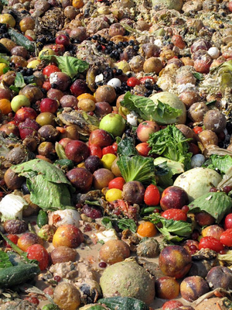

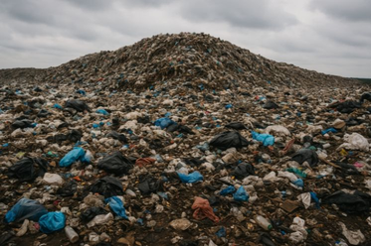
THE PROBLEM: HIGH CARBON EMISSIONS
OUR EVERYDAY CHOICES LEAVE A CARBON FOOTPRINT
DAILY ACTIVITY
CO2 EMISSIONS
TRANSPORTATION
DIRECT CO2 AND OTHER GREEN HOUSE GASES RELEASE
ELECTRICITY AND APPLIANCES
INDIRECT EMISSIONS THROUGH HEATING & COOLING
FOOD PRODUCTION AND WASTE
DIRECT GREENHOUSE GAS EMISSIONS
LANDFILLS
PRODUCES CO2 & METHANE AS IT DECOMPOSES

Slide 6
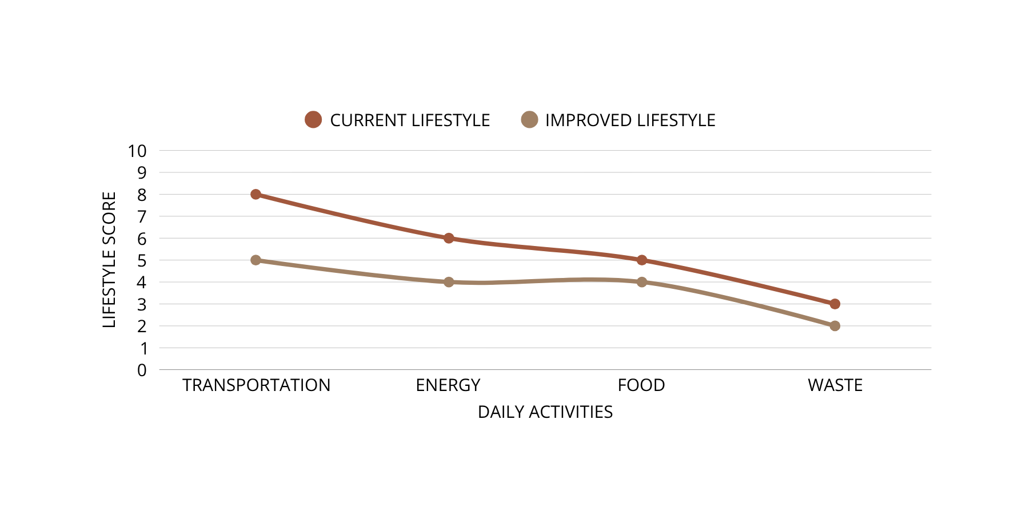


WHY DO WE NEED A CARBON FOOTPRINT CALCULATOR?
  A CALCULATOR CONVERTS EVERYDAY ACTIVITIES INTO A MEASURABLE CARBON/LIFESTYLE SCORE
  THE GRAPH SHOWS WHICH LIFESTYLE AREAS CONTRIBUTE THE MOST. A HIGHER SCORE MEANS THAT ACTIVITY HAS A GREATER RELATIVE IMPACT, MAKING THE BIGGEST CONTRIBUTORS EASY TO SPOT.
  ONCE HIGH-IMPACT ACTIVITIES ARE IDENTIFIED, USERS CAN COMPARE THEIR CHOICES AND FOCUS ON THE AREAS WHERE REDUCING EMISSIONS WILL HAVE THE GREATEST EFFECT.

Slide 7
CarbonTrack — Our Website
  An interactive carbon-footprint calculator for college students
  The website asks users about their daily habits in five categories:
Food & Drink: Dietary and food-related habits.
Transportation: Travel modes and distance.
Electricity: Electricity usage and consumption habits.
Waste: Waste-generation and recycling habits.
Everyday Consumption: Clothing, electronics and online purchases.
  Technology Used
HTML & CSS: Website structure, design and mobile compatibility.
JavaScript: Processes inputs, performs calculations and handles interactions

Slide 8
CarbonTrack — Our Website
  How It Works & What It Shows?
User inputs → JavaScript processing → Emission estimation → Results dashboard
The user completes the questionnaire using sliders and selectable options.
JavaScript applies simplified emission estimates to the collected information.
The website calculates an approximate monthly carbon footprint in kg CO₂e.
It compares the emissions from each category to identify the largest contributor.
The website is an educational prototype using approximate estimates, not a
scientifically exact carbon-accounting system.

Slide 9
CarbonTrack — Our Website
  What does the results page display?
Total estimated monthly footprint
Category-wise emission breakdown
Largest emission contributor
Personalized recommendations
Dynamic recommendations: displays suggestions related to users largest emission
category

Slide 10
WAYS TO REDUCE CARBON EMISSION
  Use public transportation
Instead of using private vehicles for every journey, we can use buses,trains,
carpooling, cycling, or walking whenever possible.
  Choose Cleaner Vehicles
We can choose vehicles that produce fewer emissions. Correct tyre pressure,
regular servicing and avoiding unnecessary idling can improve fuel efficiency.
  Reduce Electricity Consumption
Air conditioners can also be used responsibly by setting a suitable temperature
and keeping doors and windows closed while they are running.
  Use Renewable Energy
Solar and wind energy produce electricity with much lower carbon emissions than
fossil-fuel-based energy.

Slide 11
WAYS TO REDUCE CARBON EMISSION
  Reduce, Reuse and Recycle
We should reduce unnecessary consumption.We should reuse products whenever possible
instead of throwing them away after one use.Materials such as paper, plastic, glass and
metal should be separated and recycled properly.
  Make Sustainable Shopping Choices
We can avoid buying products that we do not really need and choose durable products that
can be used for a longer period.Carrying reusable shopping bags instead of using disposable
ones is another simple step.
  Save Water
Water needs to be pumped, treated, heated and transported, and all these processes
require energy.We can close taps when they are not needed, repair leaking taps and pipes,
take shorter showers and avoid unnecessary water usage.
  Use Digital Resources Wisely
We can avoid keeping unnecessary devices switched on and unplug chargers when they are
not being used.We can also extend the life of electronic devices by taking proper care of
them instead of replacing them unnecessarily.

Slide 12



FUTURE IMPROVEMENTS
  Improve accuracy using more detailed and location-specific emission data.
  Add more lifestyle categories such as water usage and travel details.
  Introduce monthly and yearly tracking of carbon footprint.
  Add visual graphs to show progress over time.
  Provide more personalized recommendations based on user behaviour.
  Develop a dedicated mobile application in the future.

Slide 13
CONCLUSION
  CarbonTrack helps users understand their personal carbon footprint.
  It converts everyday lifestyle choices into an estimated carbon emission value.
  The category-wise results help identify the major sources of emissions.
  Personalized recommendations encourage users to make more sustainable choices.
  The main goal is to turn awareness into action

Slide 14


THANK YOU

